Slide 1



Bayesian Graphical Modeling
A hands-on tutorial
PSYNETS, July 2025
n.sekulovski@uva.nl
Bayesiangraphicalmodeling.com
Credit for slides: Karoline Huth

Slide 2




Session setup
Part I: Theory
Part II: Tutorial
Part III: Practical
image: Flaticon.com

Slide 3
Session setup
Part II: Tutorial
Interpretation
Priors
Analysis (R & JASP)
image: Flaticon.com

Slide 4
interpretation

Slide 5
Two questions in network analysis
1
1
Is there an effect?
1
2
3
2
3
1
1
2
3
2
3
2
3
What is the effect?

Slide 6
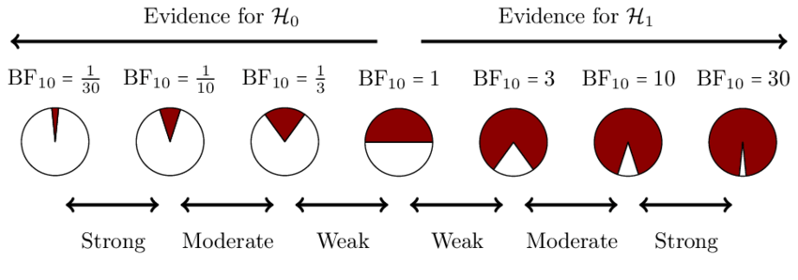
Bayesian hypothesis testing
Bayes factor as a continuous measure of evidence

Slide 7
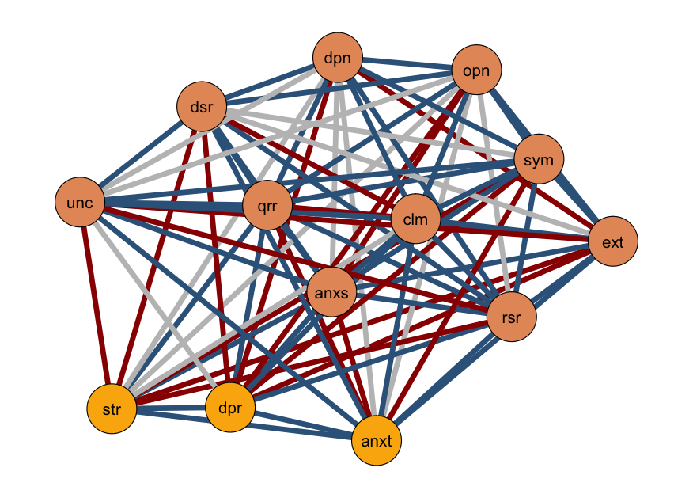
Edge evidence plot
Edge:
Inclusion Bayes factor for each edge (in categories)
Edge Color:
Evidence for inclusion
Inconclusive
Evidence for exclusion

Slide 8
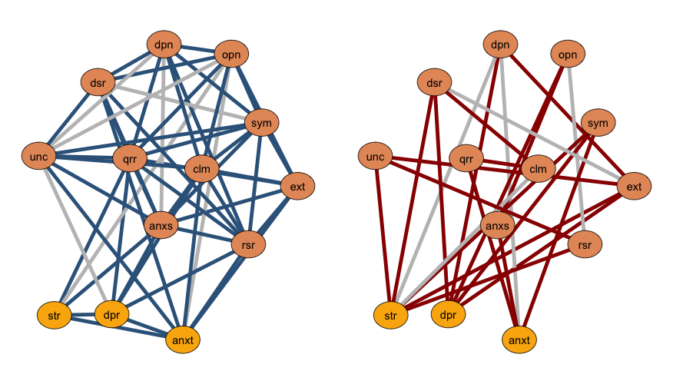
Edge evidence plot - split
Edges with a BF > 1; included
Edges with a BF < 1; excluded

Slide 9
Two questions in network analysis
1
1
Is there an effect?
1
2
3
2
3
1
1
2
3
2
3
2
3
What is the effect?

Slide 10
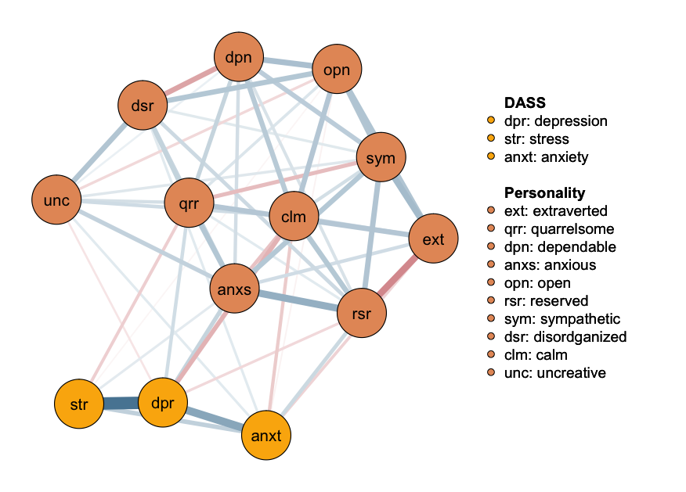
Network Plot
Median probability plot (default):
Edges with a BF > 1
Edge:
Partial association
parameter
Edge Color:
positive relations
negative relations

Slide 11
priors

Slide 12
Priors – Types & Available Options
Structure Prior
What prior assumptions do I have about the density? Do I believe a particular edge should be included?
Available options:
Independent Bernoulli
Beta-Binomial
Stochastic Block Model
Parameter Prior
What prior assumptions do I have about the strength of the edge weights?
Available options:
Cauchy distribution (with an adjustable scale parameter)
Wishart or Matrix-F priors for GGM and GCGM
Notes:
The unit information prior is a data-dependent prior, (typically multivariate Normal) with mean at the MLE, and precision equal to the information provided by one observation.

Slide 13
How do I get to my prior?
Objective Prior:
Defining an “uninformative” prior distribution
Subject matter expertise:
Using “expert” knowledge on a topic
Theoretical assumptions
Previous research:
Using previous (network) study results
Empirical data:
Using data that is similar/relevant to the one you want to assess
Always conduct a prior sensitivity check

Slide 14
analysis

Slide 15


Software implementations
easybgm
all
BDgraph
mixed, continuous, ordinal, binary
BGGM
mixed, continuous, ordinal, binary
bgms
ordinal, binary
based on Bdgraph
NEWS: In the next version of JASP all easybgm features will be available in JASP!

Slide 16
easybgm

Slide 17
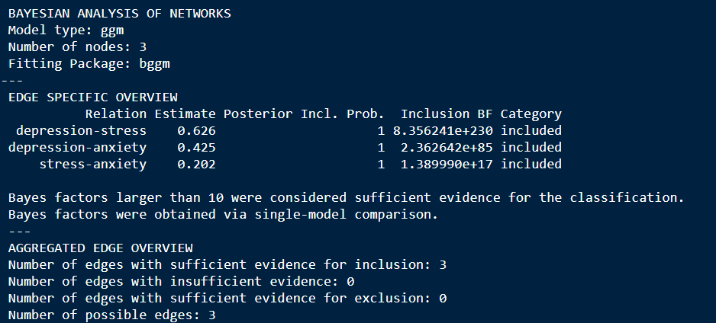
Results – main output

Slide 18
Available Plots:
Edge Evidence
Estimated Network (posterior estimated of the edge weights)
HDI (Shortest interval covering 95% of the posterior mass)
Centrality
Network Structure:
Network Complexity
The Estimated Structure.

Slide 19
A demonstration in

Slide 20
A demonstration in

Slide 21
Resources
Huth, K. B. S., de Ron, J., Goudriaan, A. E., Luigjes, J., Mohammadi, R., van Holst, R. J., Wagenmakers, E.-J., & Marsman, M. (2023). Bayesian analysis of cross-sectional networks: A tutorial in R and JASP. Advances in Methods and Practices in Psychological Science, 6(4).
Huth, K., Keetelaar, S., Sekulovski, N., van den Bergh, D., & Marsman, M. (2024). Simplifying Bayesian analysis of graphical models for the social sciences with easybgm: A user-friendly R-package. Advances
.in/psychology, e66366.
Marsman, M., van den Bergh, D., & Haslbeck, J. M. B. (in press). Bayesian Analysis of the Ordinal Markov Random Field. Psychometrika
Sekulovski, N., Keetelaar, S., Huth, K., Wagenmakers, E. J., van Bork, R., van den Bergh, D., & Marsman, M. (in press). Testing conditional independence in psychometric networks: An analysis of three Bayesian methods. Multivariate Behavioral Research.
https://bayesiangraphicalmodeling.com/
https://github.com/KarolineHuth/easybgm
https://maartenmarsman.github.io/bgms/

Slide 22
Additional Information
For more details on the Bayesian network comparison (test) please see the documentation of the bgms package as well as: Marsman, M., Waldorp, L., Sekulovski, N., & Haslbeck, J. M. B. (2024). A Bayesian Independent Samples T Test for Parameter Differences in Networks of Binary and Ordinal Variables. https://doi.org/10.31219/osf.io/f4pk9
For more details on clustering analysis, see: https://www.nikolasekulovski.com/blog/post2/
Sekulovski, N., Arena, G., Mr., Haslbeck, J. M. B., Huth, K., Friel, N., & Marsman, M. (2025). A Stochastic Block Prior for Clustering in Graphical Models. https://doi.org/10.31234/osf.io/29p3m_v1
image: Flaticon.com

Slide 23
End of Part II
Part III: Practical
image: Flaticon.com

Slide 24
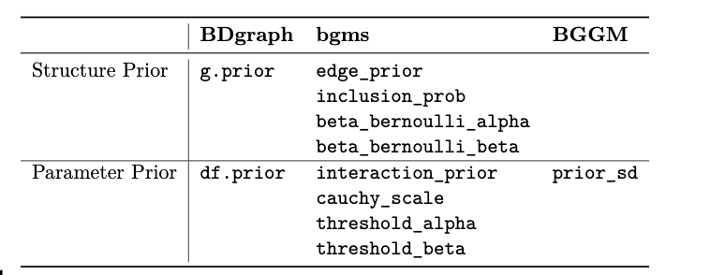
Prior – specification
Structure Prior
What prior assumptions do I have about the density? Do I believe a particular edge should be included?
Parameter Prior
What prior assumptions do I have about the strength of the edge weights?
scale

Slide 25
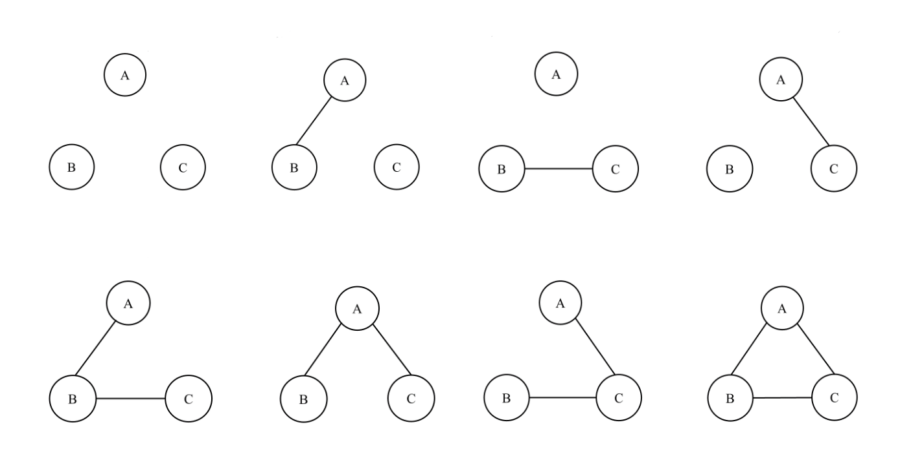
Possible Network Structures for p = 3

